Slide 1
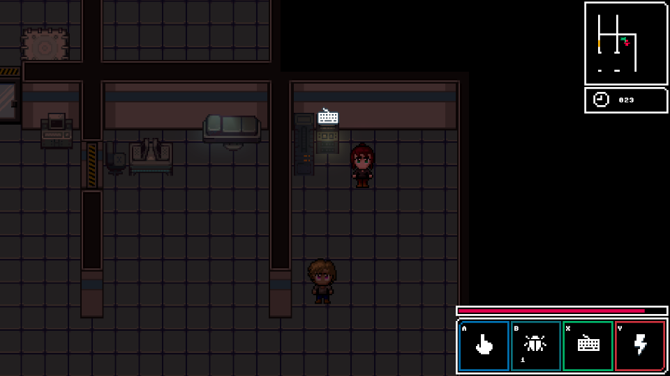
Overview
Mouse is a pixel action RPG set in a fluorescent cyberpunk world. The player controls the titular character as they
attempt to stealthily infiltrate and perform acts if espionage and sabotage against Ruby city’s ruling corporations.
Influences / Inspiration
Pacman – Frantic collection while avoiding guards/ghosts
John Wick – You took my dog (cat), revenge
Shadowrun – Cyberpunk/running
Bladerunner 2049 – Cyberpunk / What is love? / What’s it mean to be human?
DOOM – Gotta keep moving
Pokemon – Gotta collect em all
Tomb Raider – Keep the puzzles/solutions novel
Mouse
Story
The world in 2086AD has devolved into a pseudo feudal system, where corporations represent the new feudal fiefdoms and CEOs are the new lords and kings. Cities become the playthings of the corps, with the top tier corps binding together into cartels to run them. The action in Mouse takes place in Ruby district run by the Ruby cartel. The Ruby Cartel consists of the five major corps of Ruby district, Arisana Corp, Shein Biodatalytics Corp, International Data Systems Corp, Takashina Biosystems Corp, Helveti Corp and all their subsidiaries.
Much of the work force has been automated and robotised, and workers, called ‘contractors’ are the new peasants, handling the work that can’t (or won’t) be automated. The workforce is packaged and sold or rented like chattel between corporations.
Under the employment of the Arisana Corp, Mouse’s role is that as a professional thief within the system. While she’s a contractor, her role allows her greater privileges than most, to allow her steal corporate secrets and commits corporate espionage on behalf of the Arisana Corp management.
‘Imogen Agnes’
Plot
Act 0 – Milk Run
Game starts in Mouse’s apartment. It’s night. Low, messy. Her AI, Cat, sits in the corner. There is a computer beside her bed. A mobile transport for Cat is visible in the room. Her boss, Manager Lyon sends her on an easy run, to discover who is funnelling money to small town corp. Discovers a corp that is connected with Arisana
Boss seeks to uncover further information. Meet up with Snow Owl at the Arisana bar. Manager has sent Mouse on a run with recruit Snow Owl to observe. Snow Owl is to act as lookout while Mouse performs the actions of the run. The company in question should be a milk run. Upon completion of the first level, mouse uncovers direct link between Arisana and all corps, and Manager Lyon’s direct involvement. Security engages and traps Mouse and Snow Owl. Enforcers close around room. Snow Owl reveals the betrayal of Mouse’s boss
Mouse is stripped of all access, and all access to Cat is removed from her systems. Mouse is pushed out onto the street as a corp-less nobody
Act 1 – Bootstrap
Mouse is picked up off the street by free agent extraction team, a ‘robin hood’ group. Mouse is provided with early ‘ancient’ gear by agents in return for work. Gains access to ‘Kit’ to act as AI, but she is unhappy with the new personality
Act 2 – Run
Mouse uses runs to prove herself to the free agents. They promise to help her search for Cat. Mouse performs runs to survive
Act 3 – Shutdown
Mouse uncovers the illusion of rebellion. The rebellion 'frees' people from the work slavery. The media reports the company stock going down. Are you sure that's the media is showing the truth? Actually, the company's stock went up. The people chosen to free were chosen by the company to free resources. It was a cull.
“Are you telling me the rebellion work for the companies?”
“Directly? No, of course not. But it's the illusion of choice. The company's need the free agents. It's to their benefit. You think of the free agents as parasitic, but really, they are symbiotic. The rebellion are slave traders. They reinvest any good resources back into the business and turf the rest. Just enough to keep the free folk down.”
Mouse focuses on revenge. Discovers sabotaging one corp just causes another to fill in. Disillusioned, she leaves the free agents.
Act 4 – Reboot
Mouse becomes her own a free agent, able to take jobs at will
Mouse continues to search for cat, while discovering the new friendship in Kit
Game Design
2D Top down “JRPG” style game
Pixel like effect, scales with screen size
Roguelike randomized dungeons
Enemies are randomized
Action is real time (unlike JRPG style)
Players are given a small minimap to navigate
The player isn’t provided any weapons and is at a disadvantage against enemies.
Levels are timed.
Player is given an energy bar that acts as an economy from which they can spend to perform different actions
Player needs to balance stealth and other challenges against time pressure.
Actions
The game is designed to use a simplified gamepad control scheme. Alternatively, onscreen keys will support mobile play
Direction Keys
Interact/Use
Bug – Uses consumable, credit items
Hack – Uses less energy, but requires an action timer / mini game
Overload – Uses much more energy, but is instant
Select – Show inv/character sheet etc
Start – Game options, quit etc
Mouse – Olivia Hart
Olivia is the main protagonist. At 27 years old, she is a veteran of the cyber espionage business.
She has coloured magenta hair, green eyes, a black leather jacket and tan combat boots, showing off her contractor street style
Cast
Cat (C.A.T.)
Lyon
Snow Owl
Gibson
Aero
Stitch
Cloud
Clique
Crash
Kit (K.I.T.)
Enemies
Security Guards
Scientists/Technicians
Enforcers
Ghosts
Spider Drones
Hawk Drones
Other infiltrators
Traps / Impediments
Security Cameras
Trip lasers
Pressure pads
Heat scanners
Security Locks & Puzzles
Keycards
Palette
Mouse features a pastel colour palette
Neon Pink represents Mouse.
Other colours represent different UI choices
Other colours also represent corps
Targeted Platforms
Windows Desktop
Android
iOS
WebGL (if possible)
Terminology
Contractor – A Serf in the new society
Manager – A Knight/Baron in the new society
CEO – The new age kings
Corp – Corporation, a controlling entity in the city. Modern equiv. to a medieval fief
© hacked.design

